Slide 1

AI Ethics, Innovation, & Accessibility
Emily Hand, Ph.D.
emhand@unr.edu

Slide 2
About Me
2
Assistant Professor of CSE at UNR
Member of the Computer Vision Lab
Affiliate Faculty
UNR Cybersecurity Center
UNR Integrative Neuroscience Program
Director of the Machine Perception Lab

Slide 3
Machine Perception Lab
3
Machine Learning + Human Perception

Slide 4
4

Slide 5
MPL Active Projects: NLP
5
Natural Language Processing
Identifying bias in political news
Domain-specific typo correction
Automated text summarization
Sarcasm detection from text
Modeling user language

Slide 6
MPL Active Projects: Vision
6
Computer Vision
Describing faces using attributes
Recognizing faces using caricatures
First impression recognition
Micro-expression recognition

Slide 7
MPL Active Projects: ML
7
Machine Learning
Dynamically adjusting model architectures
Identifying and removing noisy data

Slide 8









My Team
8
Nicole
Sara
Dusty
Cody
Derek
Jeremy
James
Nate
Bryson

Slide 9
Current State of Ethics in AI
9
Fairness.
Robustness.
Transparency.
Explainability.

Slide 10
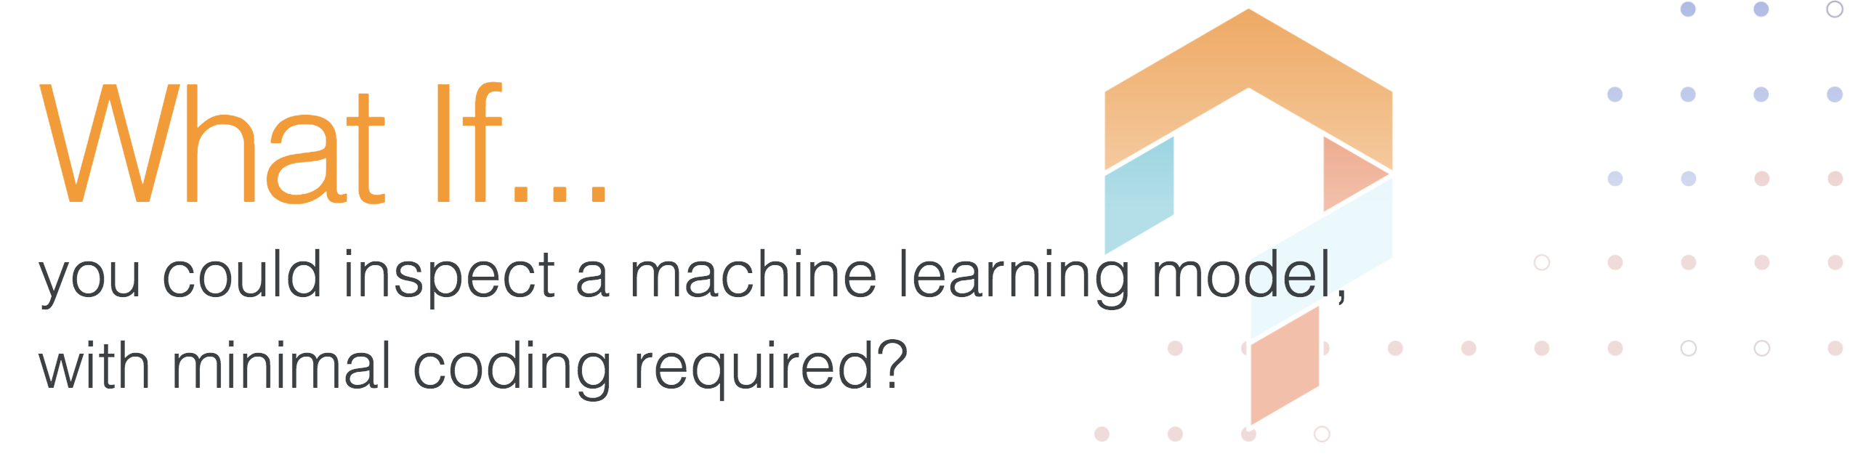
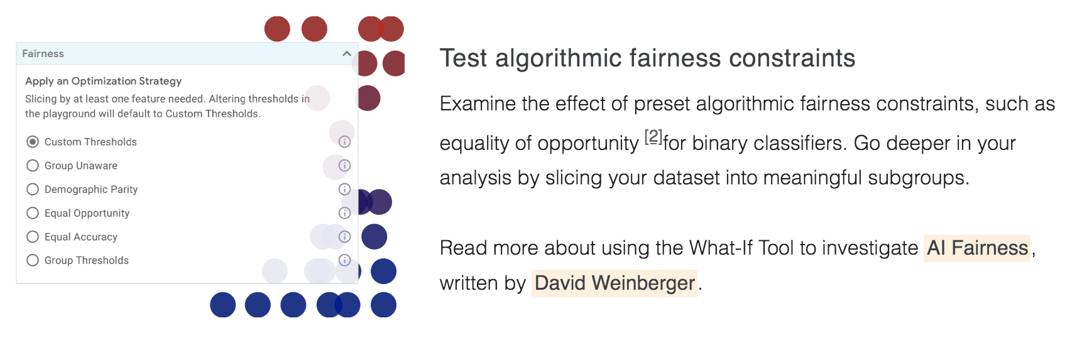
Google’s What-If Tool
10
Fairness

Slide 11
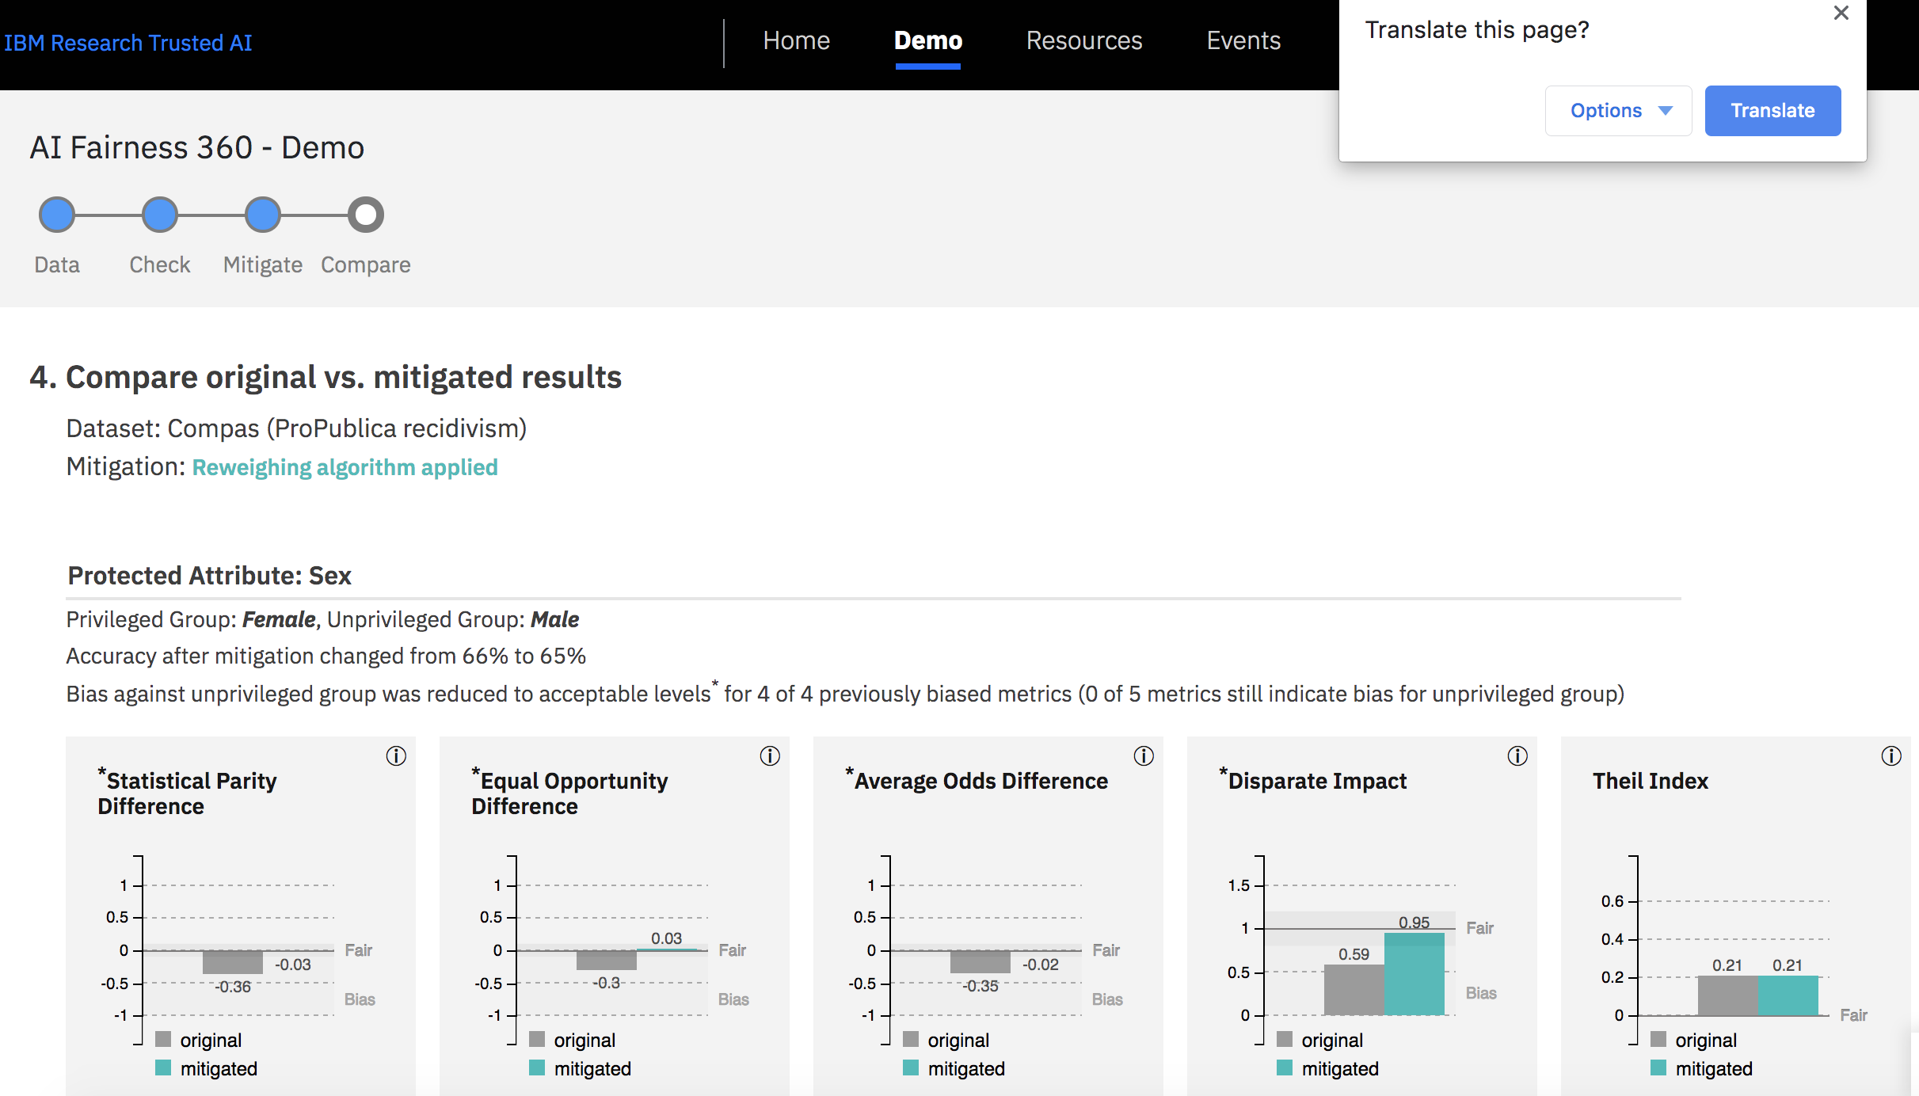
IBM’s AI Fairness 360
11
Fairness

Slide 12
IBM’s AI Fairness 360
12
Fairness

Slide 13
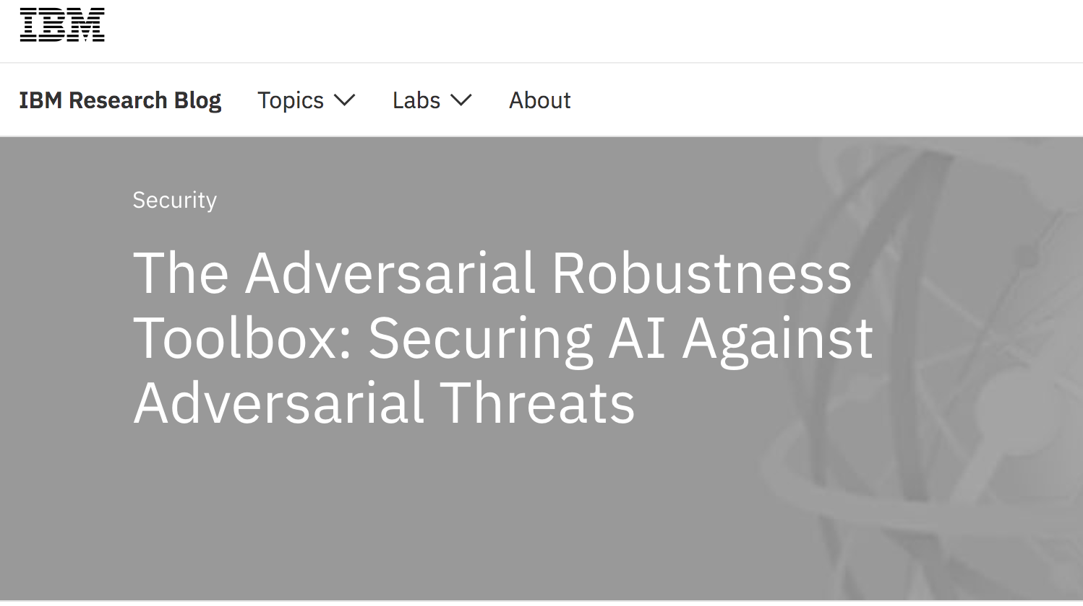
IBM Adversarial Robustness Toolkit
13
Robustness

Slide 14
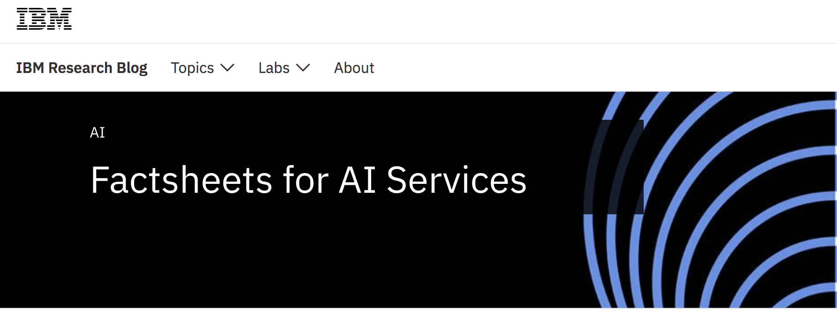
Factsheets
14
Transparency

Slide 15
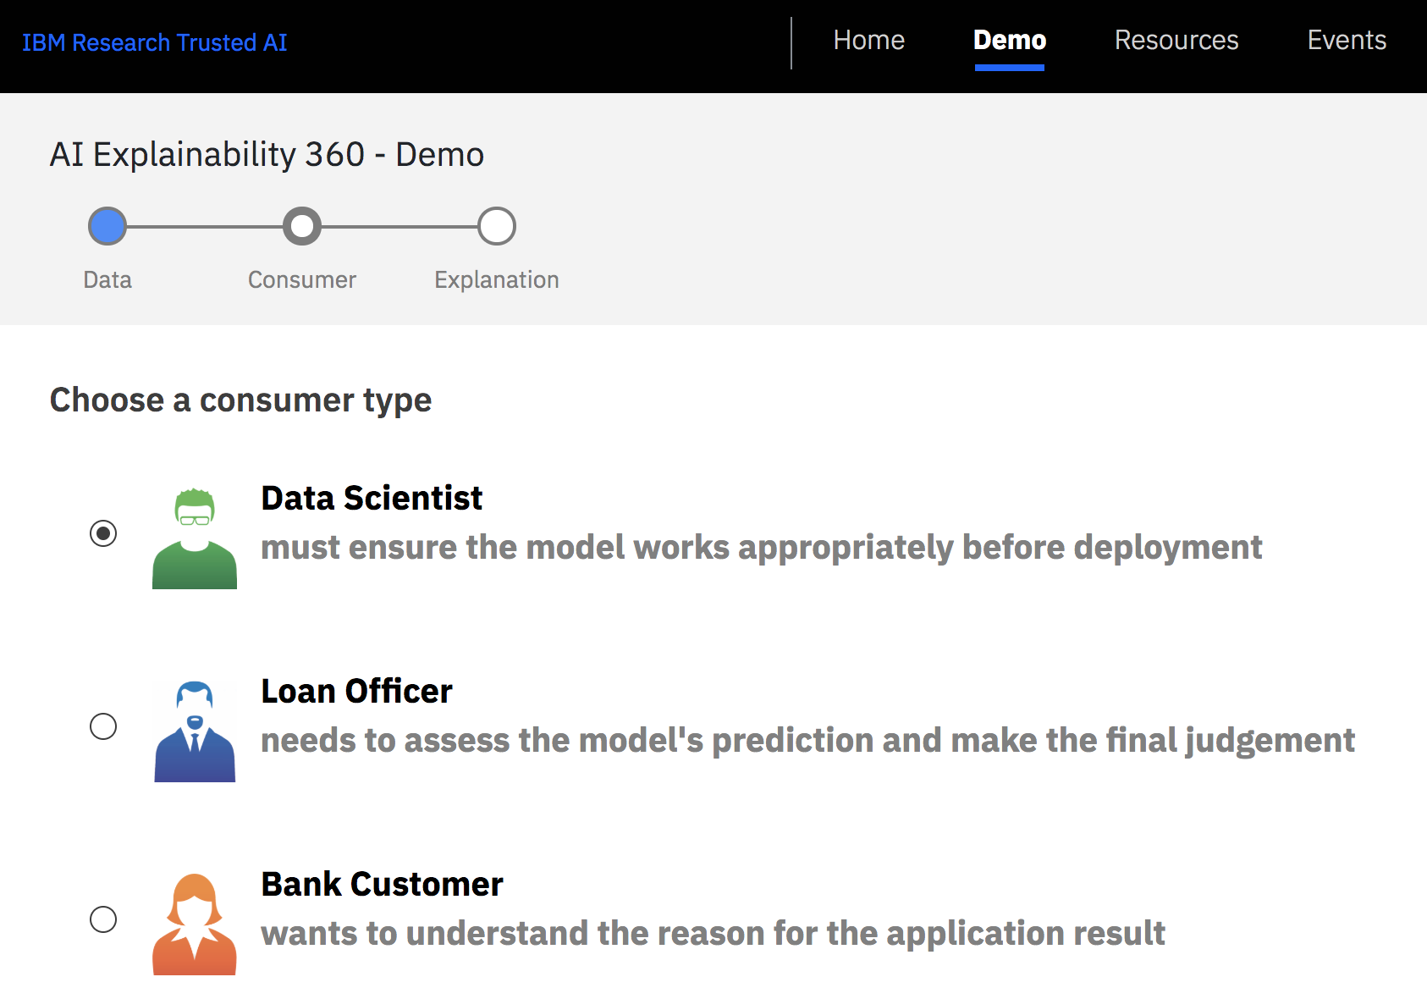
AI Explainability 360
15
Explainability

Slide 16
Ethics in AI
16
None of these get to the heart of what it means for a system to be ethical.

Slide 17
Problems with “Ethical AI”
17
STEM professionals defining ethics.
Many times an afterthought.

Slide 18
Ethical AI
18
Artificial Intelligence that is Ethical
Behaves morally.
Serves the interest of the people.

Slide 19
Ethical AI: Moral AI
19
AI that behaves morally.

Slide 20
Ethical AI: Moral AI
20
AI that behaves morally.
Moral: concerned with the principles of right and wrong behavior.

Slide 21
Ethical AI: Moral AI
21
AI that behaves morally.
Moral: concerned with the principles of right and wrong behavior.
Attributing human characteristics or behavior to a program.

Slide 22
Ethical AI: Moral AI
22
AI that behaves morally.
Moral: concerned with the principles of right and wrong behavior.
Attributing human characteristics or behavior to a program.
Anthropomorphism

Slide 23
Ethical AI: Moral AI
23
AI that behaves morally.
Moral: concerned with the principles of right and wrong behavior.
Attributing human characteristics or behavior to a program.
Anthropomorphism
Dangerous

Slide 24
Ethical AI: Moral AI
24
A moral agent is a person who has the ability to discern right from wrong and to be held accountable for his or her own actions.

Slide 25
Ethical AI: Moral AI
25
A moral agent is a person who has the ability to discern right from wrong and to be held accountable for his or her own actions.
Moral agents have a moral responsibility not to cause unjustified harm.

Slide 26
Ethical AI: Moral AI
26
A moral agent is a person who has the ability to discern right from wrong and to be held accountable for his or her own actions.
Moral agents have a moral responsibility not to cause unjustified harm.
Traditionally, moral agency is assigned only to those who can be held responsible for their actions.

Slide 27
Ethical AI: Moral AI
27
A moral agent is a person who has the ability to discern right from wrong and to be held accountable for his or her own actions.
Moral agents have a moral responsibility not to cause unjustified harm.
Traditionally, moral agency is assigned only to those who can be held responsible for their actions.
AI

Slide 28
Ethical AI: Moral AI
28
A moral agent is a person who has the ability to discern right from wrong and to be held accountable for his or her own actions.
Moral agents have a moral responsibility not to cause unjustified harm.
Traditionally, moral agency is assigned only to those who can be held responsible for their actions.
AI

Slide 29
Ethical AI: Moral AI
29
Who is responsible for the morality of artificial intelligence systems?
Creator
User

Slide 30
Ethical AI
30
Artificial Intelligence that is Ethical
Behaves morally.
Serves the interest of the people.

Slide 31
Ethical AI: Serving AI
31
AI that serves the interest of the people.

Slide 32
Ethical AI: Serving AI
32
AI that serves the interest of the people.
No anthropomorphism.

Slide 33
Ethical AI: Serving AI
33
AI that serves the interest of the people.
No anthropomorphism.
AI should be used for the common good.

Slide 34
Ethical AI: Serving AI
34
AI that serves the interest of the people.
No anthropomorphism.
AI should be used for the common good.
Which people are being served?

Slide 35
Ethical AI: Serving AI
35
AI that serves the interest of the people.
No anthropomorphism.
AI should be used for the common good.
Which people are being served?
Diversity, Equity & Inclusion

Slide 36
Ethical AI: Serving AI
36
Who is responsible for ensuring that an AI system is serving the people?
Creator
User

Slide 37
Ethical Failures of AI
37

Slide 38
IBM Watson for Oncology
38
IDEA: identify patterns in significant amount of patient data hopefully leading to some kind of cure

Slide 39
IBM Watson for Oncology
39
IDEA: identify patterns in significant amount of patient data hopefully leading to some kind of cure
Trained on “synthetic” patient data

Slide 40
IBM Watson for Oncology
40
IDEA: identify patterns in significant amount of patient data hopefully leading to some kind of cure
Trained on “synthetic” patient data
Unsafe and incorrect treatment recommendations

Slide 41
Microsoft’s Tay
41
Twitter Chatbot for conversational understanding

Slide 42
Microsoft’s Tay
42
Twitter Chatbot for conversational understanding
From 0 to racist in 24 hours

Slide 43
Amazon Recruiting Tool
43
Automated resume reviewer

Slide 44
Amazon Recruiting Tool
44
Automated resume reviewer
Learned male candidates were best

Slide 45
How do we deal with bias in innovation?
45
How do we teach the innovators of tomorrow?

Slide 46
Automation Bias
46
Humans favor suggestions from automated decision-making systems.

Slide 47
Automation Bias
47
Humans favor suggestions from automated decision-making systems.
Ignore contradictory information made without automation, even if it is correct.

Slide 48
Next Generation of Innovators
48

Slide 49
Universal Design in Learning
49
Educational framework focused on accessibility and improved learning for all.

Slide 50
Universal Design in Innovation
50
Designing with accessibility in mind will lead to disruptive and useful technology.

Slide 51
Universal Design in Innovation
51
Virtual Assistants
Siri
Alexa
Google Home
Ridesharing Services
Uber
Lyft

Slide 52
Ethics & Self-Driving Vehicles
52
Liability
Safety
Public Trust
Notes:
People are taking Echo and Google Home out of their homes because they’re concerned with their privacy.
How will they behave when it is an issue of safety?

Slide 53
Ethics & Self-Driving Vehicles
53
Visually Impaired
Mentally Disabled
Physically Disabled

Slide 54
Open Questions
54
How can we design technology for people with…
Autism
Visual Impairments
Physical Disabilities
How can we increase public trust in AI?
How can we improve public perception of AI?

Slide 55
Thank you!
Universal Design in Innovation → Disruptive Technology

